Slide 1
OLA RIDE ANALYSIS
Name : Meeval Augustine

Slide 2
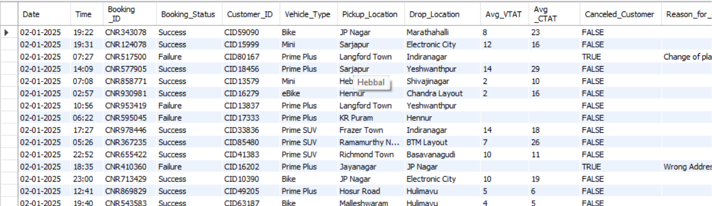
SQL SOLUTIONS
1.Creating database for ola rides :
Create database ola;
2.Retrieving all data :
select * from ola;

Slide 3
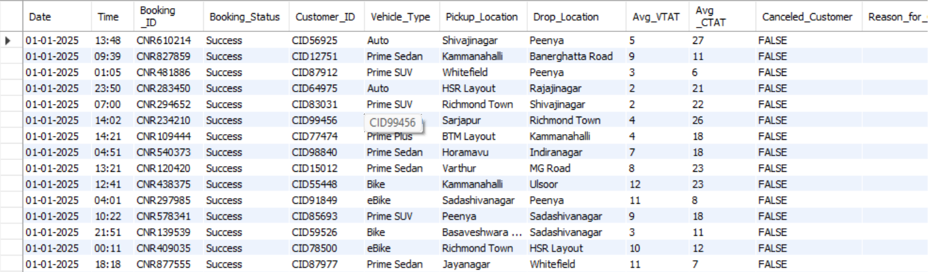
3.Retrieve all successful bookings:
select * from ola where booking_status="success";

Slide 4
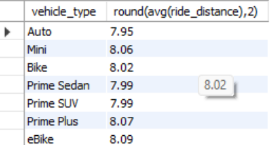

4. Find the average ride distance for each vehicle type:
select vehicle_type,round(avg(ride_distance),2) from ola group by vehicle_type;
5.Get the total number of cancelled rides by customers:
select count(canceled_customer) as canceled_customers from ola where canceled_customer="true";

Slide 5
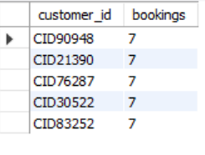

6.List the top 5 customers who booked the highest number of rides:
select customer_id,count(booking_id) as bookings from ola group by customer_id order by bookings desc limit 5;
7.Get the number of rides cancelled by drivers due to personal and car-related issues:
select count(Reason_for_Canceling_by_Driver) as drivers_canceled from ola where Reason_for_Canceling_by_Driver="Personal & Car related issue";

Slide 6

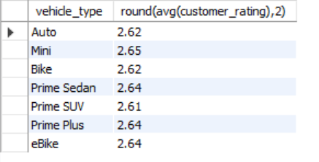
8.Find the maximum and minimum driver ratings for Prime Sedan bookings:
select vehicle_type,max(driver_ratings),min(driver_ratings) from ola where vehicle_type="prime sedan";
9.Find the average customer rating per vehicle type:
select vehicle_type,round(avg(customer_rating),2) from ola group by vehicle_type;

Slide 7

10.Calculate the total booking value of rides completed successfully:
select incomplete_rides,round(sum(booking_value),2) from ola where incomplete_rides="false";

Slide 8
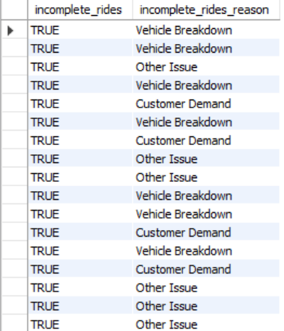
11.List all incomplete rides along with the reason:
select incomplete_rides,incomplete_rides_reason from ola where incomplete_rides="true";

